Slide 1
Game Pitch: <GAME_NAME>
Computer Games Laboratory 2017 / 2018
Team “Pick One”:
Muhammad Inshal Uddin
Paul Preissner
Jonas Mayer
Artem Bishev
Technical University of Munich
08.11.2017

Slide 2
Considerations
Exciting and qualitative on the one side
Feasible to tackle for a small team of students with zero artistic skills – on another.
Unveil a “Together” topic.
Pick a good genre: something that let us to stay on a well-tried, solid ground, but also to introduce something novel and fresh into it.
Explosions!

Slide 3
So, we decided on a…
Cooperative Dungeon Crawler
Diablo-like gameplay for players, which everyone (almost) loves: run, collect loot, fight enemies.
Players have unique abilities and need to cooperate to make their way through procedurally-generated levels.
Rogue-like elements to make game shorter, but lively and replayable.

Slide 4
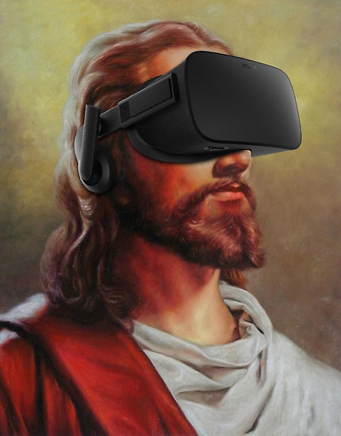
Novel feature: Dungeon Master
Godlike entity mounted with HTC Vive! (Or some other VR glasses).
Have absolutely unique set of abilities and different gameplay.
Sees the entire level from a giant’s perspective and guides the players.
Jesus Christ in Oculus Rift – from redbubble.net

Slide 5
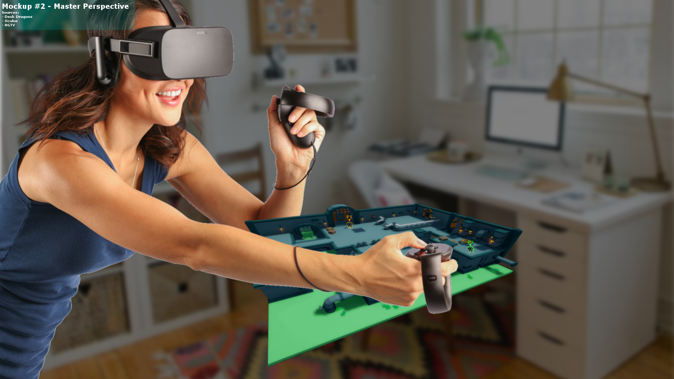
Mockup

Slide 6
Crawler’s gameplay – “Diablo”
Controls a small character.
Run through the level, kill monsters, gather loot.
See only what’s happening around them, don’t see the entire map.
Can die! But also can make their way through the game and finish it.
Different players have different abilities.
Need to effectively communicate with the master to reach their goals, rely on her.
Have a limited skillset that does not allow them to see the information about the entire level or about other crawlers, cannot see traps, cannot essentially alter the dungeon…

Slide 7
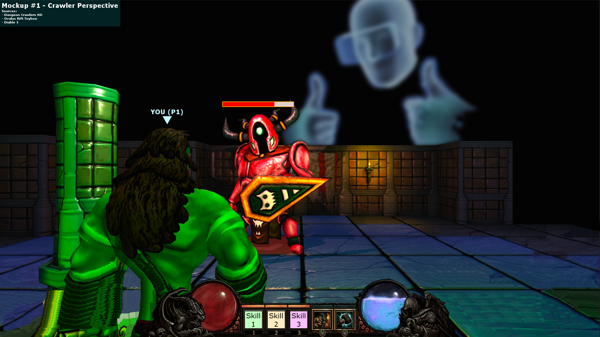
Mockup

Slide 8
Master’s gameplay – “Star Craft“
Ideally, a VR player. Can walk around the dungeon, seeing everything what happens from above, and focus on certain areas of interest.
Guides the crawlers, helps them to survive and find each other.
Has absolutely unique set of abilities that allows her to alter the entire level, heal and buff the crawlers, and inflict mass damage to the level inhabitants.
But the most importantly: he shares the information. Need to warn other players about dangers and show them the best way through the level.
Has limited, but restorable resources

Slide 10
HEAL
GUIDE
BLOCK ENEMIES

Slide 12
Master’s gameplay
Very challenging role!
Have to micromanage a lot of tasks:
helping out all crawlers at once, considering that they might be scattered throughout the level
augment and explore the dungeon
spot and weaken the enemies
wisely spend his resources

Slide 13
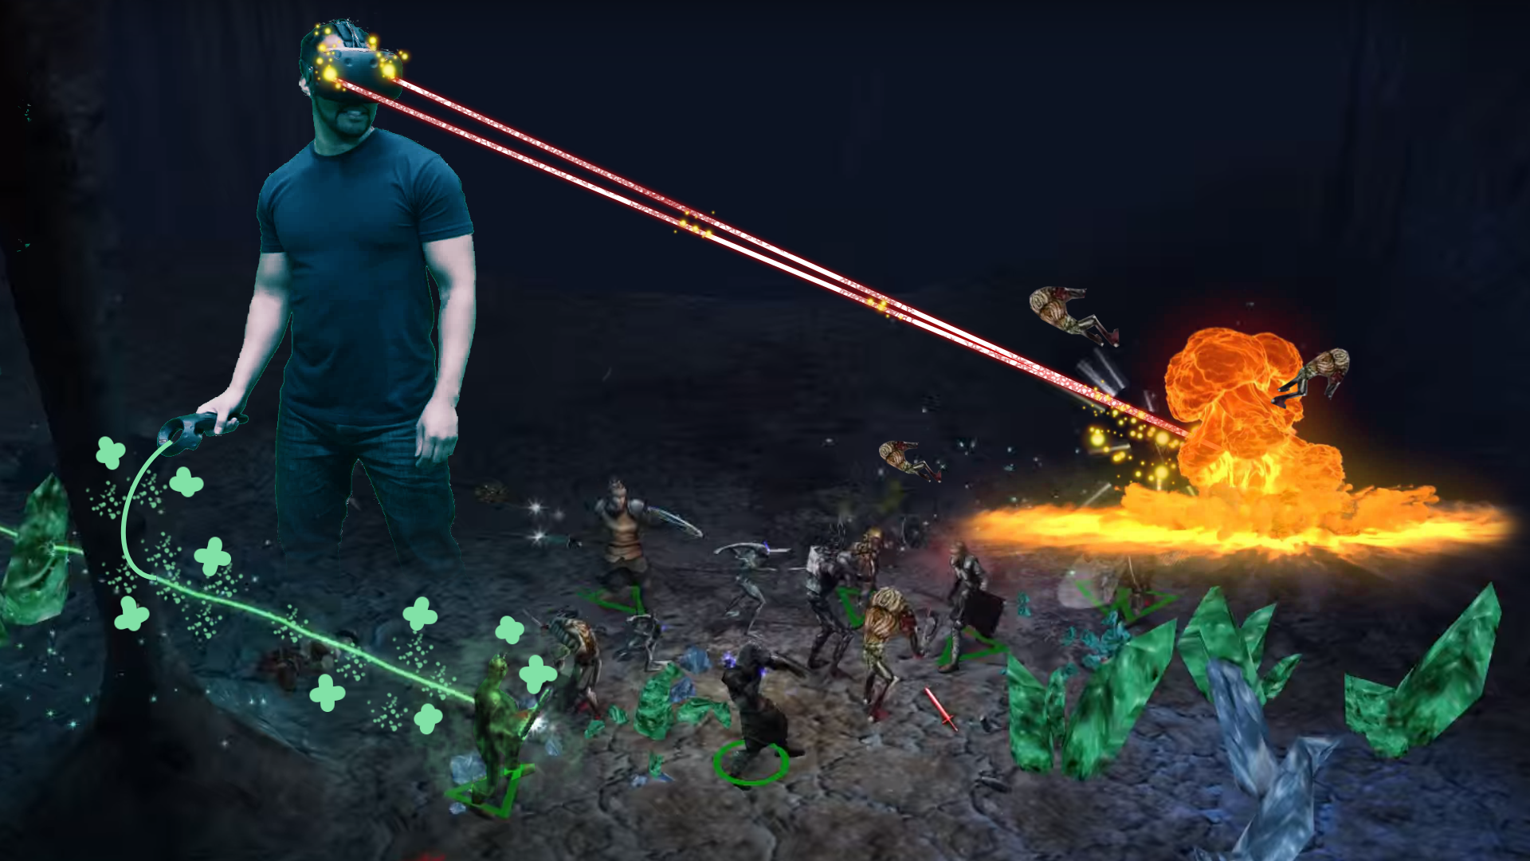
Mockup

Slide 14
Together
Our game is much more about cooperation than other dungeon crawlers or roguelike games!
Different forms of cooperation are involved:
Cooperation between the crawlers.
Cooperation between each crawler and the master.

Slide 15
Together
Cooperation between the crawlers is crucial, because:
The most difficult enemies cannot be defeated by a single crawler: players have to gather together to defeat the boss.
Cooperation between a crawler and the dungeon master is crucial, because:
Players cannot even find each other in a dungeon if wander without a guidance.
We intentionally don’t want to make the level layout uniformly fair towards the players. Came across a group of overpowered enemies, triggered a lethal trap? And DM has not prevented this from happening? Then die!
Some places of dungeon can be designed so that players physically cannot get through without being coordinated.

Slide 16
Together
Possible level layout

Slide 17
Game setting
We have a dungeon crawler, but dungeons are boring, so we have a modern setting: downtown full of neon lights. Does not demand many visuals, but looks very catchy!
What is the plot? Why someone helps players from above? Easy!
Players go through the different levels of a fortified high-rise tower in order to rescue their friend from a rivalling clan.
While he’s being kept for his supernatural powers and is unable to escape by himself, he uses his powers to guide and support his friends on their way up.

Slide 18
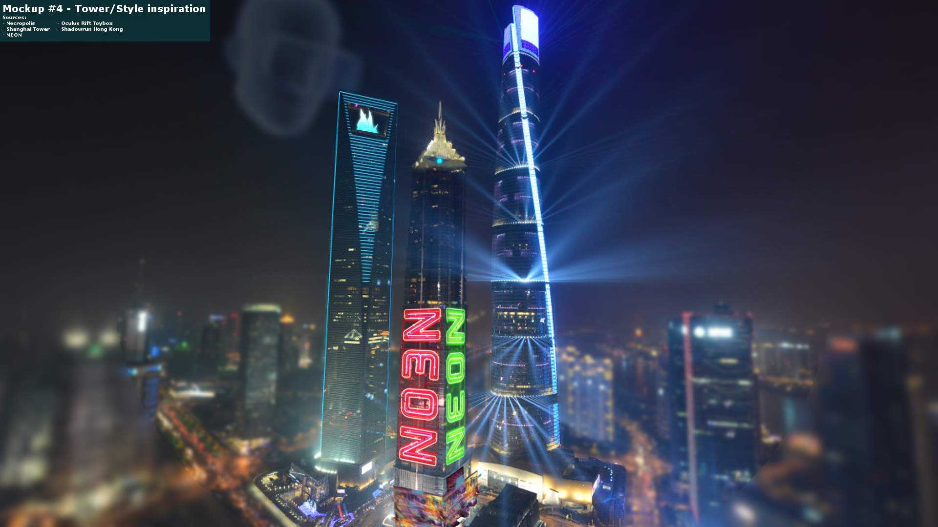

Slide 19

Inspiration: Downtown

Slide 20
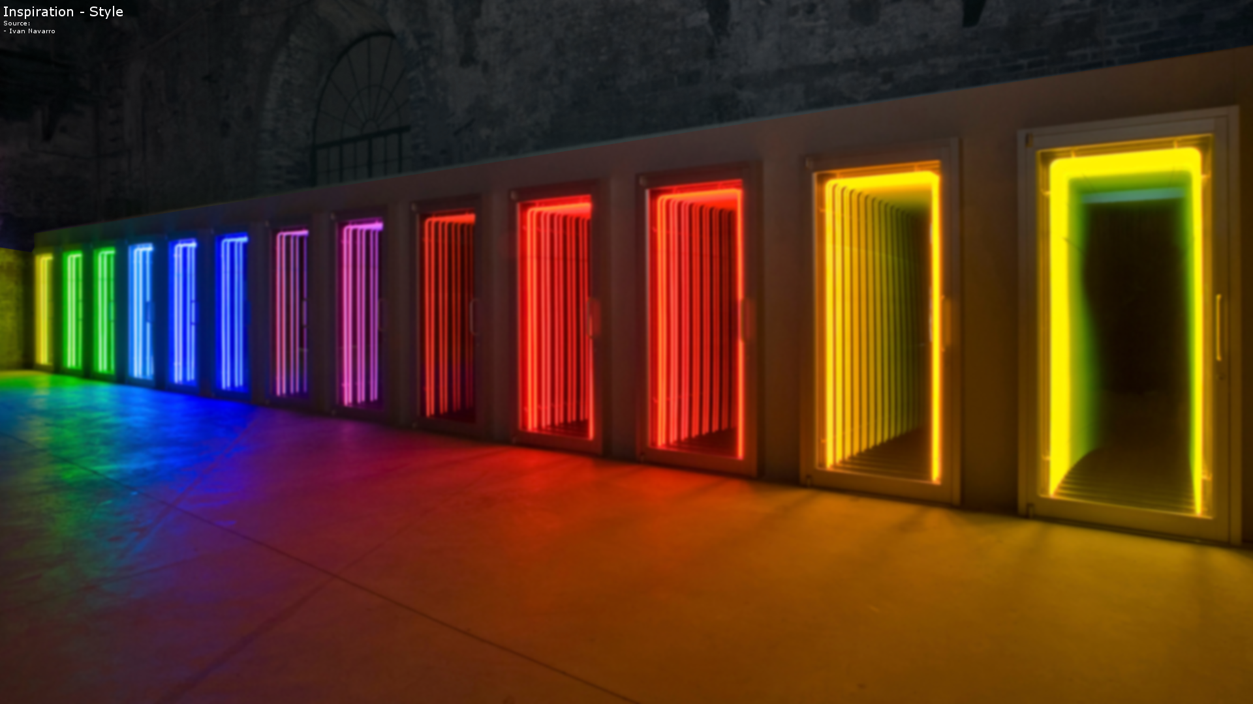
Inspiration: Neon Lights and Colors

Slide 21
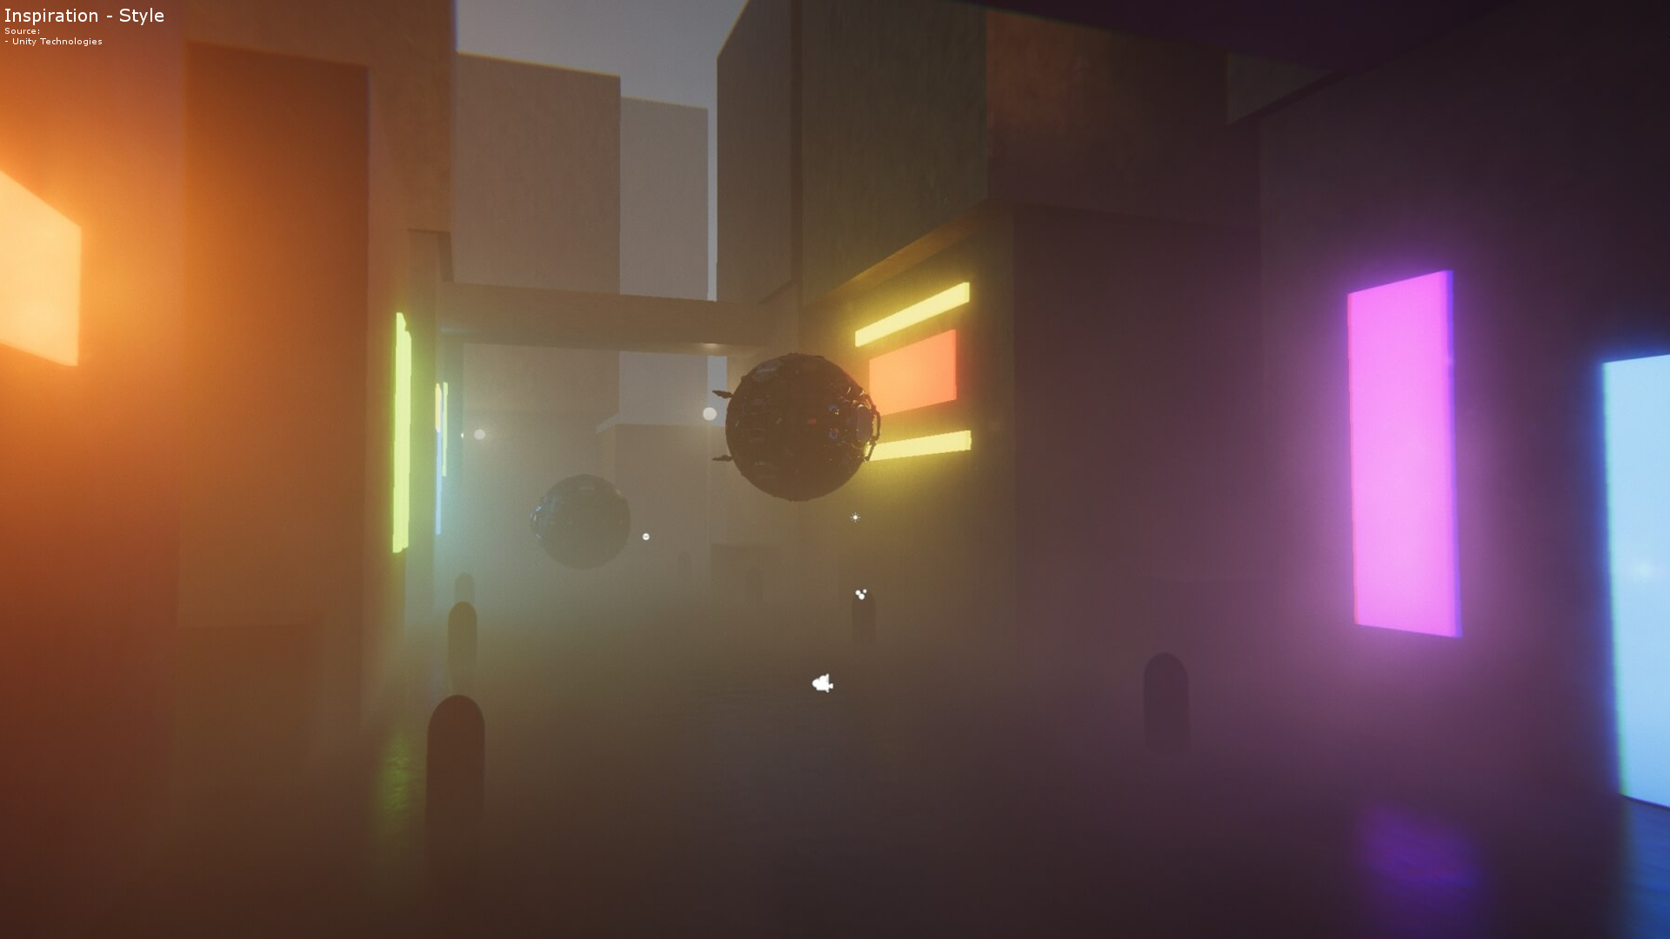
Inspiration: Simplistic Style

Slide 22
Technical details
Everything is in 3D, but the level layout is mostly flat for better perception
Crawlers use mere PCs
Dungeon Master uses HTC Vive or analogical VR equipment
Game is created in Unity3D
Networking for players’ synchronization
Decent graphics and physics to let DM explode things
Procedural generation to make enjoyable levels
Minimalistic game setting to avoid creating too much visual assets

Slide 23
Challeges
Create some visually pleasant assets, make levels look good.
Game balance: make a game difficult enough (so it cannot be completed from the first run), but also make it fun and enjoyable.
Design and distribute different abilities among the players so that their cooperation is really meaningful.
Make sure that neither DM nor the crawlers are getting bored.
Implement ambitious technical stuff, especially networking.
Think hard on what (items, perks, skills) should we add to our game in limited time to make different runs unique and remarkable.

Slide 24
Summary
SIMPLISTIC STYLE
SHARE INFO ABOUT LEVEL
MICROMANAGEMENT
COMMUNICATION
UNIQUE ABILITIES
PROCEDURAL
GENERATION
PUZZLES
ROGUE-LIKE
UNITY 3D
TOGETHER
VR
EXPLOSIONS
TRAPS
DUNGEON
CRAWLER
ZERO ART
SKILLS
GODLIKE
ENTITY
NEON LIGHTS
ENEMIES
NETWORKING
STAY ALIVE
GIANT DUNGEON MASTER
BOSS
LOOTBOXES
SMALL LEVELS
DOWNTOWN

Slide 25
Thanks for your attention!
Muhammad Inshal Uddin
Artem Bishev
Jonas Meyer
Paul Preissner

